Slide 1

Processing
Ethan Look

Slide 2
What is Processing?
Code within the context of visual arts
Compatible with most platforms
Easy to learn
Used as a teaching tool
Java, JavaScript, Python, Android
2D and 3D art with user interaction and animation

Slide 3
Confused?
Ask me.
ethan.a.look@vanderbilt.edu
Check out Processing documentation
https://processing.org/reference/
Check out this session content
https://github.com/ethanlook/VandyHacks-Hacker-Night-2016-11-3

Slide 4
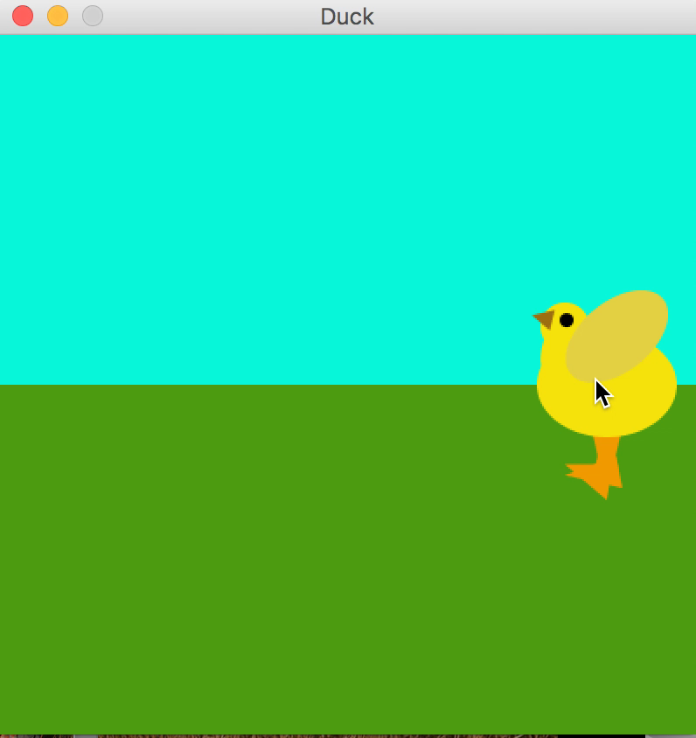

Slide 5
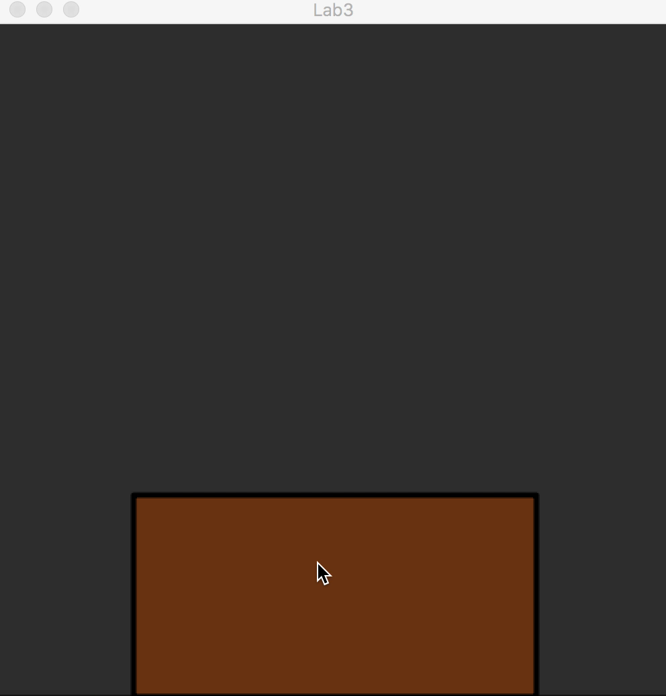

Slide 6
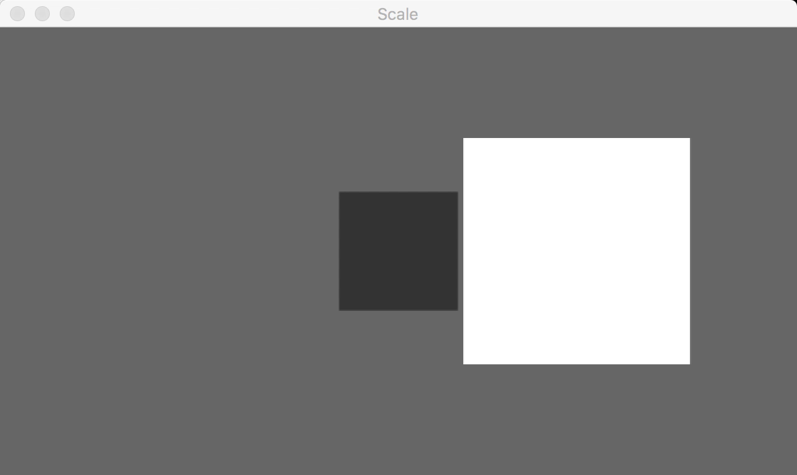

Slide 7
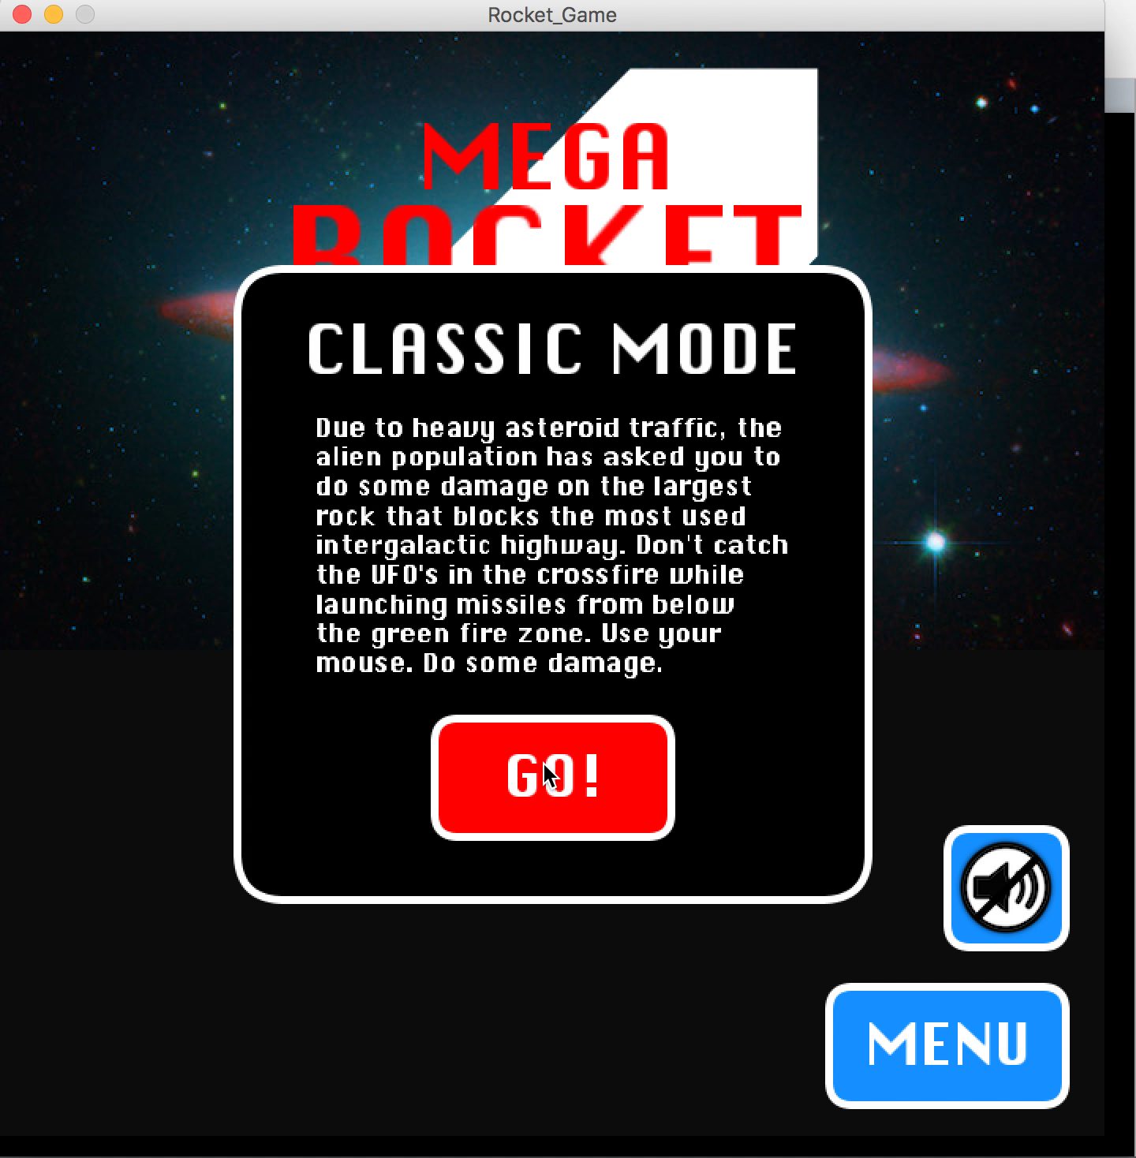

Slide 8
Program Structure
// The statements in the
// setup() function
// execute once when the
// program begins
void setup() {
// Size must be the
// first statement
size(640, 360);
// Set line drawing
// color to white
stroke(255);
// Set the frame rate to
// 30 frames per second
frameRate(30);
}
// The statements in draw()
// are executed until the
// program is stopped. Each
// statement is executed in
// sequence and after the
// last line is read, the first
// line is executed again.
void draw() {
// Draw a red circle in
// the middle of the
// screen.
fill(255, 0, 0);
ellipse(width/2, height/2,
100, 100);
}

Slide 9
The Processing Coordinate Space
(0, 0)
width
x
height
y

Slide 10
Basic Drawing
// Can “paint-over” the entire background. Values between 0-255.
background(r, g, b);
// Can also set the background color on a grayscale from 0-255.
background(gray);
// Sets the fill color for the scene. You can set it as many times as you need.
fill(r, g, b);
fill(gray);
// Can also do no fill. Makes the object “see-through”.
noFill();
// Sets the stroke color for the scene. Can also do grayscale.
stroke(r, g, b);
stroke(gray);
// Can also do no stroke.
noStroke();

Slide 11
Drawing Shapes
// Ellipse with center (a, b), width c, height d.
ellipse(a, b, c, d);
// Line with endpoints (x1, y1) and (x2, y2).
line(x1, y1, x2, y2);
// Rectangle with upper-left corner at (a, b), width c, height d.
rect(a, b, c, d);
// An arc. Think of a “pie slice” of an ellipse. Center (a, b), width c, height d. Start at radian value start, end at radian value end. Goes clockwise.
arc(a, b, c, d, start, stop);
// A triangle with vertices (x1, y1), (x2, y2), (x3, y3).
triangle(x1, y1, x2, y2, x3, y3);

Slide 12
An Example of Drawing
A House

Slide 13
Now, Draw a Smiley Face
5-10 minutes
Ask me any questions

Slide 14
Using Global Variables
Can use global variables to make changes over time.
Has an effect like animation.
From previous example, we can make the house move.
Need to repaint the background each time!
int x, y;
void setup() {
size(600, 400);
// x and y of the upper left of the house.
x = 0;
y = height/2 - 75;
}
void draw() {
// Set the background color.
background(0, 150, 200);
// Draw the grass
fill(0, 255, 0);
noStroke();
rect(0, height/2, width, height/2);
// Draw the house
fill(204, 102, 153);
rect(x, y, 200, 75);
// Draw the roof
fill(102, 51, 0);
stroke(0);
strokeWeight(2);
triangle(x - 10, y, x + 100, y - 50, x + 210, y);
x = x + 2;
}

Slide 15
Make your Smiley Face Go Back and Forth
5-10 minutes
Ask me any questions

Slide 16
Using Click Events
At any time, can use the mouse location with mouseX and mouseY.
Can capture mouse click events with mouseClicked()
When used with ArrayLists, can do interesting things.

Slide 17
Using Click Events
ArrayList<Integer> houseXs = new ArrayList<Integer>();
ArrayList<Integer> houseYs = new ArrayList<Integer>();
void setup() {
size(800, 600);
}
void draw() {
// Set the background color.
background(0, 150, 200);
// Draw the grass
fill(0, 255, 0);
noStroke();
rect(0, height/2, width, height/2);
// Draw all of the houses.
for (int i = 0;
i < houseXs.size(); i++) {
drawHouse(houseXs.get(i),
houseYs.get(i));
}
}
void mouseClicked() {
houseXs.add(mouseX);
houseYs.add(mouseY);
}
void drawHouse(float x, float y) {
// Draw the house
noStroke();
fill(204, 102, 153);
rect(x, y, 200, 75);
// Draw the roof
fill(102, 51, 0);
stroke(0);
strokeWeight(2);
triangle(x - 10, y,
x + 100, y - 50,
x + 210, y);
}

Slide 18
Make a Smiley Face Every Time You Click
5-10 minutes
Ask me any questions

Slide 19
Questions?
ethan.a.look@vanderbilt.edu

